Slide 1
Architecture and Processes
Business Intelligence & Analytics

Slide 2
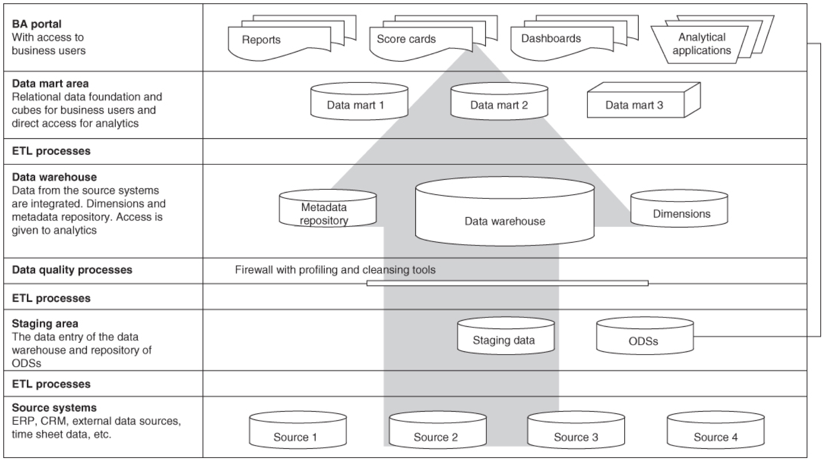

Slide 4
etl
Extract – data from source table
Transform – for business use
Load – to target table in the data warehouse or different locations outside the data warehouse
Set up as jobs on a schedule (or via some other trigger)
ETL jobs may include data already in the data warehouse

Slide 5
Transform
Primary purpose of an ETL process
One or more steps to modify the data
Typically done using Structured Query Language (SQL)
Other types of systems now available
Translating coded values – for example, the source system is storing “M” for man and “W” for woman, but the data warehouse wants to store the value 1 for man and 2 for woman.
Mapping of values – For example, mapping of the values “Man,” “M” and “Mr.” into the new value 1.
Calculating a new calculated value – For example, sales = number × unit price.
Joining from different sources – For example, to look‐up or merge.
Summing up of several rows of data – For example, total sales for all regions.
Generating a surrogate key –This is a unique value attributed to a row or an object in the database. The surrogate key is not in the source system; it is attributed by the ETL tool.
Transposing – Changing multiple columns to multiple rows or vice versa.

Slide 6
Load
At the end of the process, the transformed data is loaded into a specific target table in the data warehouse
Data in the target table is either replaced or appended to (so long as it is an existing target)

Slide 7
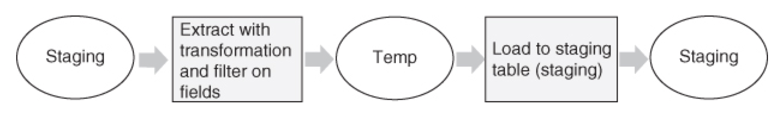
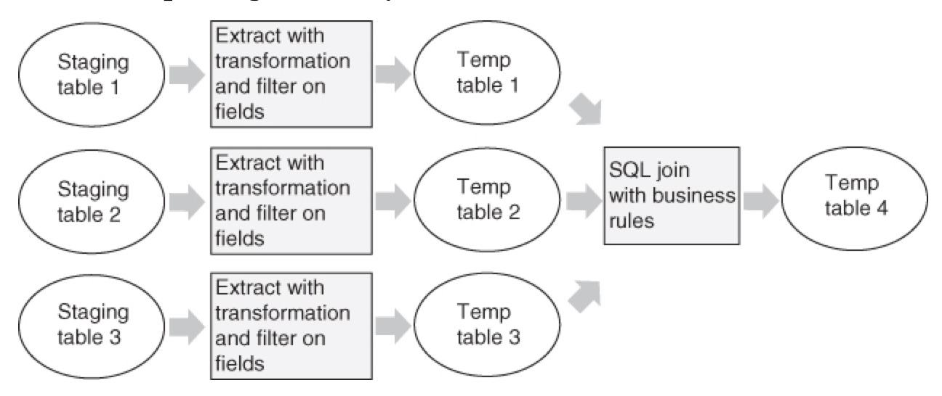
Example ETL processes

Slide 8
Process timing
Realtime
Happen as the data is accessed
Pull data from tables as they exist at run time
Scheduled
Happen at a time specified by the ETL developer
Pull data from tables as they exist at run time
Triggered
Process will run based on a specified trigger
Often the trigger will be an update from one of the inputs to the process
All other tables are loaded in their current form

Slide 9
Data warehouse structure
Details about Extract, Transform, Load (ETL) processes

Slide 10


